Slide 1

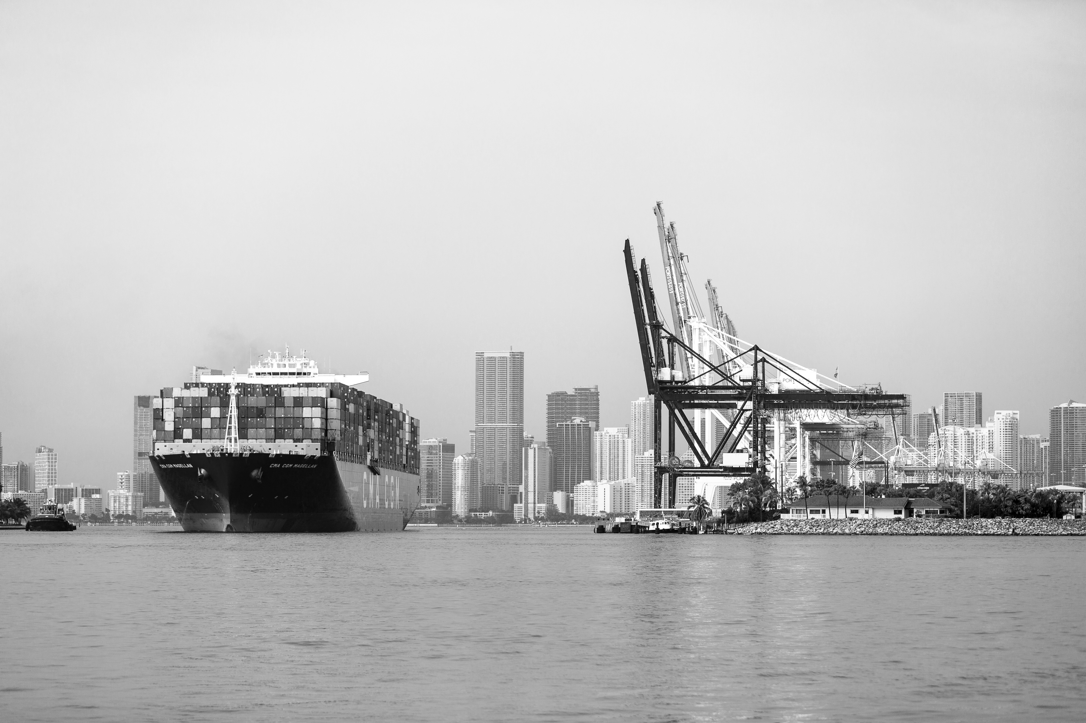
Growing Business in Florida: Opportunities
April 2023
Notes:
Objective: Understand where we are and how we got here. Collect buy in for my vision for the future: Florida to The World 2030

Slide 2
What EFI Does: Retain/Recruit Businesses
Enterprise Florida (EFI) is here to help retain, grow, and attract high wage jobs for Floridians. By facilitating business investment, retention, and expansion in targeted industries, and through marketing and promotion, EFI bolsters Florida’s economy. Dynamism and resiliency result.
ATTRACT
GROW
HIGHER WAGE
JOB GROWTH AND ECONOMIC RESILIENCY
RETAIN

Slide 3
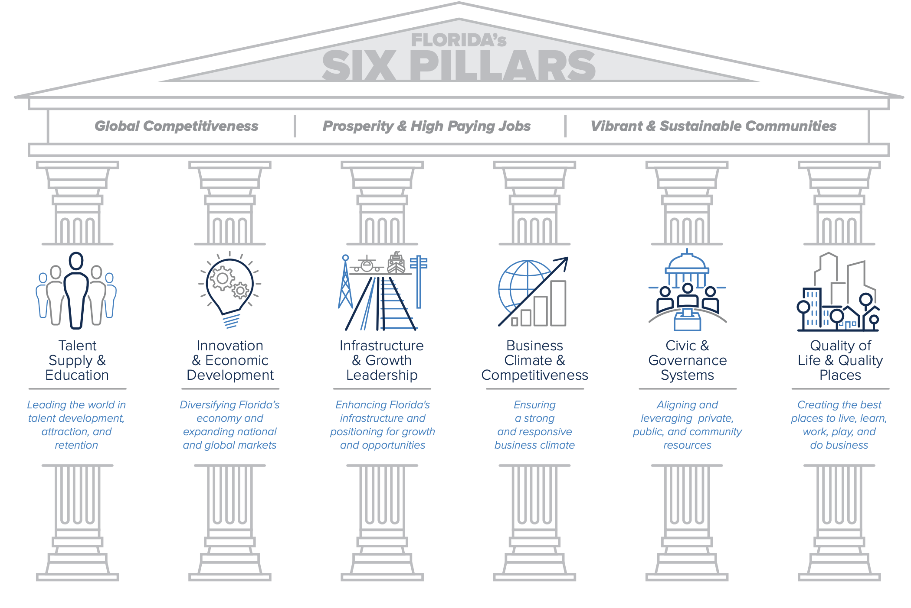
Florida’s 6 Pillars
Notes:
Florida’s vision: Florida will have the nation’s top‐performing economy and be recognized as the world’s best place to live, learn, play, work and do business.
Goal 1: Lead the nation in resilient and sustainable economic growth and prosperity.
Goal 2: Lead the nation in global competitiveness as a location for talent, business, innovation and tourism.
Goal 3: Lead the nation in quality of life and quality places for residents, communities and visitors.
Objective
(O1) – Educate, attract and retain top talent.
(O2) – Foster opportunities for prosperity and business growth.
(O3) – Expand global commerce
(O4) – Grow and sustain quality jobs and employment.
(O5) – Increase and sustain Florida’s attractiveness to workers, residents and visitors.
(O6) – Build and maintain resiliency of Florida’s quality of life and quality places.
27 strategies… we are directly supporting/responsible for 10… but the 5 most important:
Four out of Four (4/4) strategies in Pillar #2
(P2) Innovation and Economic Development - Diversifying Florida’s economy and expanding national and global markets.
2.1 Transition established clusters to serve new markets and expand emerging talent and innovation clusters.
2.2 Support public, military and private industry partnerships and integrated efforts related to research and development, innovative technology transfer and commercialization.
2.3 Encourage export growth and market diversification.
2.4 Brand and consistently market Florida as the best state for business.
P4) Business Climate and Competitiveness Ensuring a strong and responsive business
4.5 (NEW) Encourage industry diversification to ensure a sustainable business climate

Slide 4

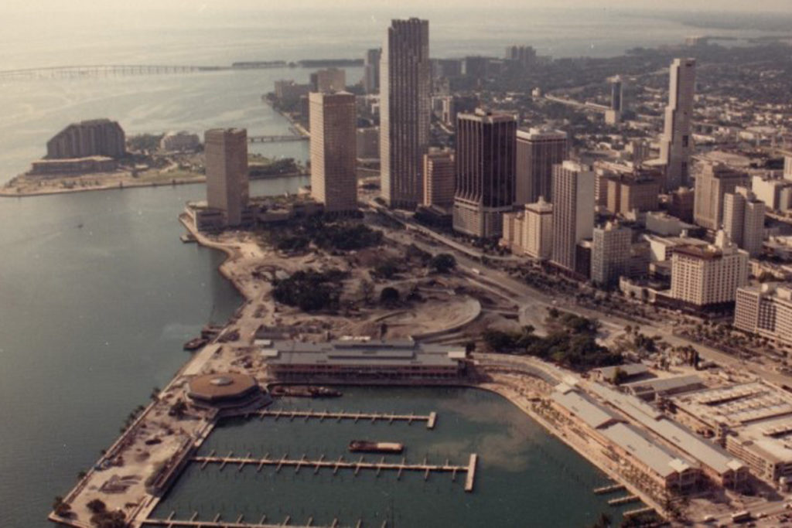
Old Florida
Notes:
Florida is very New.
Least populated southern state in 1940.
Non diversified industry: focused on agriculture, retirees, and tourism/hospitality

Slide 5

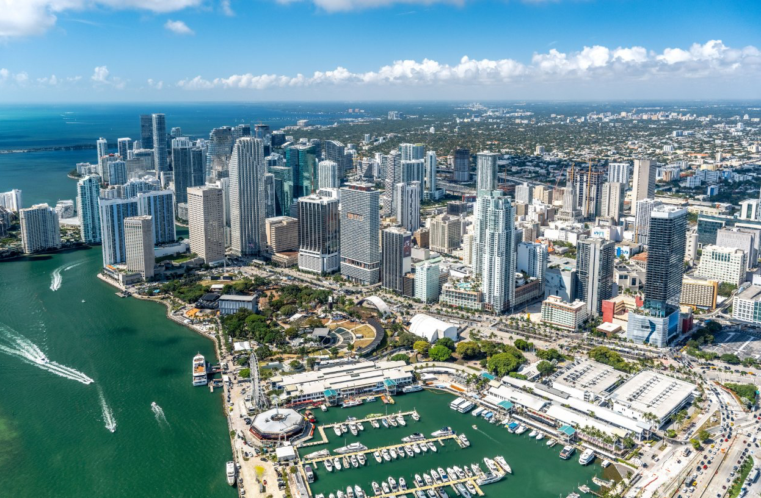

New Florida
Notes:
Fitting that once Florida became popular with the advent and ubiquity of AC in the 1960s around the state, we launched the first manned rocket to space from the CAPE.

Slide 6

Why?
Notes:
2 things: 1) For 30 years Florida has been making smart investments. 2) the world has gone mad and Florida is at the right place/time to take advantage
Its not just what we have done… its what everyone else is doing or failing to do…
Maybe its because it is what happens to every society, market, economy in time. But not in Florida. Since I have lived here, I have only known Florida as GROWTH. Why?

Slide 7
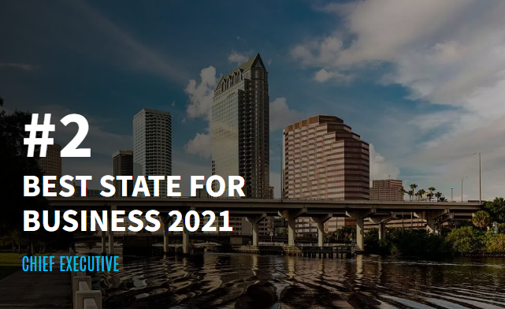
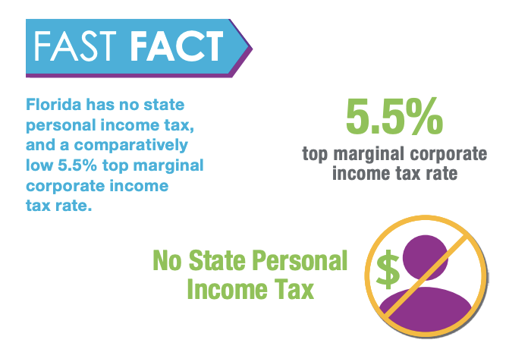
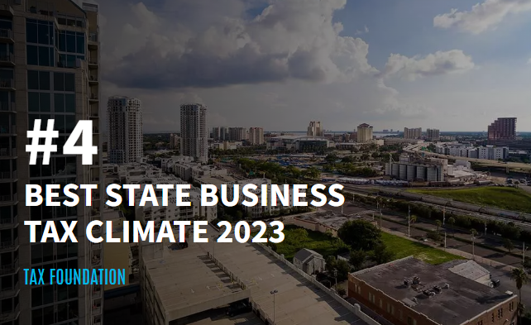
Pro Business Framework
Notes:
We created one of the best business fiscal and regulatory environments in America.
1) Business Friendly Climate
We are looking at bringing in high growth company to Florida for manufacturing. One of their board members moved to Miami over the pandemic and he told us he feels liberated.
Florida is constantly ranked among the most business-friendly states in the United States. Low tax rates, political and monetary stability, regulatory predictability, enforceability of contracts, probusiness policies, and competitive business and living costs make Florida an attractive location for practically any type of business facility.
California, New York, Illinois, rank horribly on regulation and fiscal impact. Meanwhile political instability in our South.
\

Slide 8
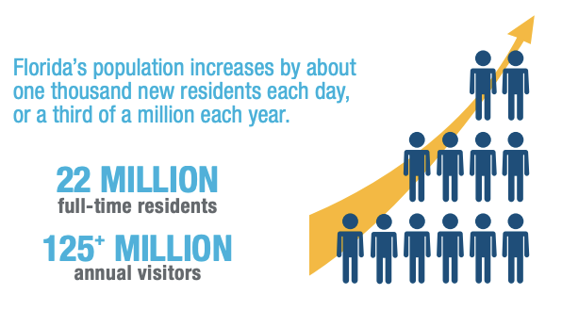
Large Dynamic Market
Notes:
Florida’s trillion-dollar-plus economy is the 4th largest among U.S. states, and among the Top 20 in the world – bigger than those of the Netherlands or Mexico, and about the same size as Spain. Home to about 22 million residents, Florida is now the 3rd most populous U.S. state, with one of the fastest growing economies. This vast, dynamic market offers tremendous business opportunities for international companies across a range of economic sectors.
\

Slide 9

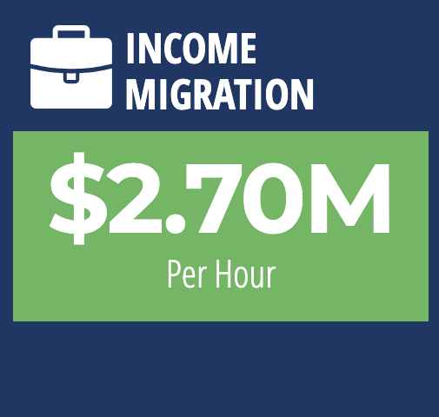

Capital
Notes:
This is newer addition to the list because it is a new phenomenon…
Tax act of 2017
Florida is getting very rich very quickly. Next closest is Texas at $700k every hour net. We are blowing away other states in income and capital attraction. My job is to make sure international brand keeps up with pace of domestic brand. So many people and wealth is moving here, internatonal investors don’t truly understand the scope/impact.
Florida saw a net migration of 20,263 high earning households from 2019 to 2020—four times as much as the next most popular state, Texas.
Kelly Smallridge Wall Street South in Palm Beach
ARK Invest Moves to St. Pete
Always been a financial hub due to South America/Latin America but this is a whole new level
\

Slide 10
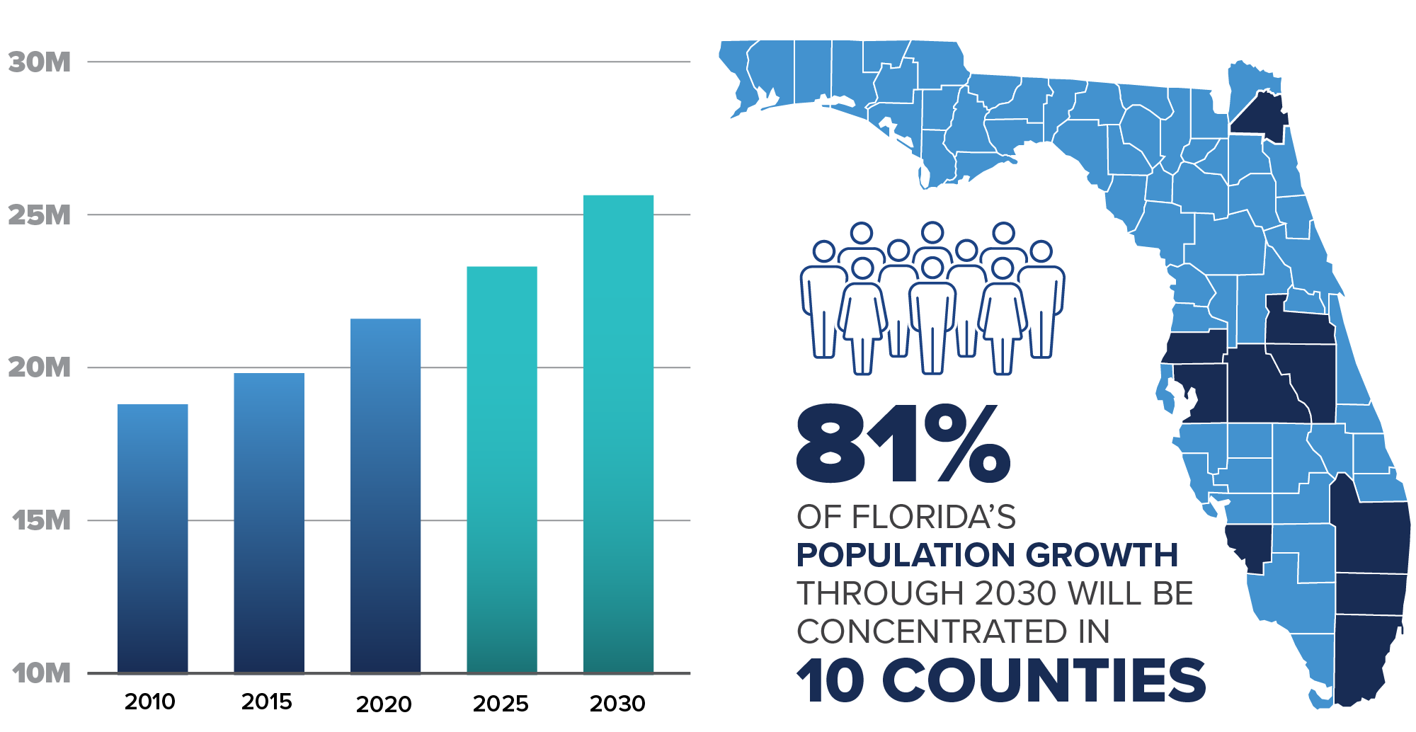
Florida’s Population and Growing Economy
Notes:
Population and economic growth are not new for Florida. Florida added 2.7 million residents (15 percent) and had the largest net migration of any state between 2010 and 2020.
Florida could add as many as 3.5 million additional residents between 2021 and 2030. Gross domestic product (GDP), employment, and visitors are expected to grow quickly as well.
Population growth will be heavily concentrated in 10 urban counties, but every county is expected to see some growth during this period. This means more demand for a wide range of consumer goods and business equipment statewide.
Note if asked: source is the BEBR high growth forecast.

Slide 11
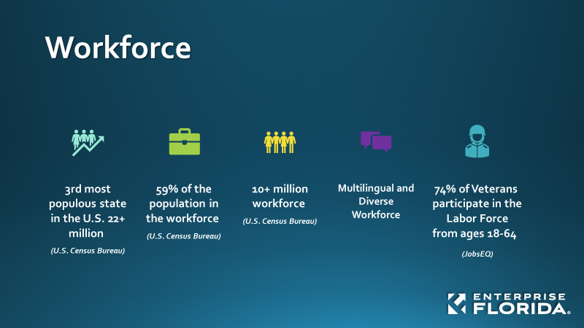
Talent
Notes:
Geography is Destiny!
Florida is host to several thousand affiliates of companies based outside the United States, including hundreds of hemispheric or regional corporate headquarters. Besides corporate HQ’s, many international firms have located other kinds of facilities in Florida, such as manufacturing plants, R&D labs, sales and marketing offices, logistics and distribution operations, and customer service centers, to take advantage of easy access to markets worldwide.
Florida is the Americas’ commercial crossroads. Due to its strategic geographic location, advanced infrastructure, access to finance, and multi-cultural and multi-lingual workforce, Florida serves as the principal gateway to Latin American and Caribbean markets for both U.S. and overseas companies. Florida accounts for about a third of total U.S. trade with Latin America and the Caribbean, and is home to the world’s largest cluster of professional & financial service providers specializing in Latin America.
There are more direct flights from Florida airports to Latin American and Caribbean cities than from the rest of the United States combined. Miami is regularly voted “best Latin American city for business” by CEOs.
As the home to America’s space program and the birthplace of IBM’s personal computer, Florida has a long history of developing and deploying innovative technologies. Nowadays more than 36,000 high-tech business establishments employ about 600,000 Floridians, generating some $12-13 billion in high-tech exports annually. Florida’s biotech firms are behind some of humanity’s greatest health breakthroughs, while its fintech and cyber security professionals are ensuring the smooth, secure conduct of online business. From marine biology to space exploration, propulsion systems to surgical lasers, Floridians are devising cutting-edge solutions for the next economy.
Florida is home to more than 58,000 exporting companies – second only to California. Twenty percent (20%) of the nation’s companies that export are in Florida.
Florida ranks 4th among all U.S. states in high-tech exports – reaching US$13.8 billion in 2021 – and 3rd in the U.S. for the 40.7 thousand direct jobs supported by tech exports in 2018.
One of the most international US states, with global name recognition
A hemispheric hub for business, finance, trade, logistics, travel, and culture
Multicultural & multilingual: 1/5 of Florida’s population (and over half of Miami’s) born outside the United States and speak a foreign language.
One of the highest concentrations of foreign consulates, trade offices, bi-national chambers of commerce, and international banks in the US
Business gateway between Latin America & Caribbean and rest of the world; location for many LatAm regional corporate headquarters, and the US offices of companies based in Latin American countries
Miami regularly voted “best Latin American city for business” by CEOs
As part of the US, Florida enjoys political and economic stability, rules-based legal system, enforceability of contracts, few restrictions on capital flows
Geographic proximity to LatAm, advanced infrastructure, and connectivity
Florida’s diverse, multilingual workforce includes several million native speakers of Spanish, Portuguese, and French – easy to find the right talent
Extensive cultural, linguistic, and family ties to Latin America & Caribbean
Close to 2500 multinational firms, many are regional headquarters for LatAm
The world’s largest cluster of professional & financial service providers specializing in Latin American and Caribbean markets
The largest cluster of international banks in the US outside of New York

Slide 12
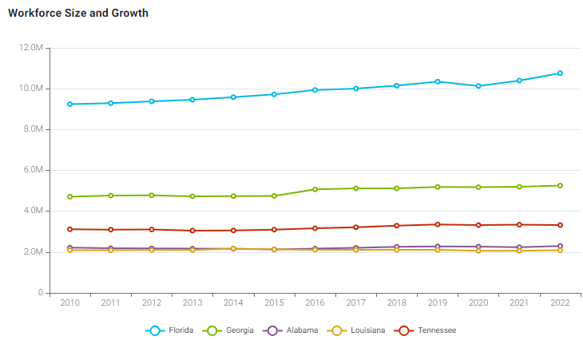
Talent
Notes:
Source: Interactive data from EFI Website; https://www.enterpriseflorida.com/why-florida/workforce/
2) We invested heavily in making our higher education system affordable and world-class. We also have other preeminent, specialized universities.
NYU vs UF.
Florida’s 10.5 million-strong workforce is highly educated, technically skilled, and culturally and linguistically diverse, renowned for its strong work ethic. Globally prominent academic institutions, modern scientific and technical curricula, businessacademia partnerships, and top-rated customized worker training programs make it easy to find the qualified talent needed by almost any kind of business. Florida’s labor costs are highly competitive, especially compared to other top-tier business locations in the United States and most other advanced economies.
Florida average annual manufacturing wages are 20% lower than those in Texas, and 35% lower than California’s.
2.5 million people in the pipeline.
Not to mention how we benefit from all the talent to our south.
Governor DeSantis has also made it a huge priority to focus on technical education
Tech talent and engineering at a number of bootcamps

Slide 13
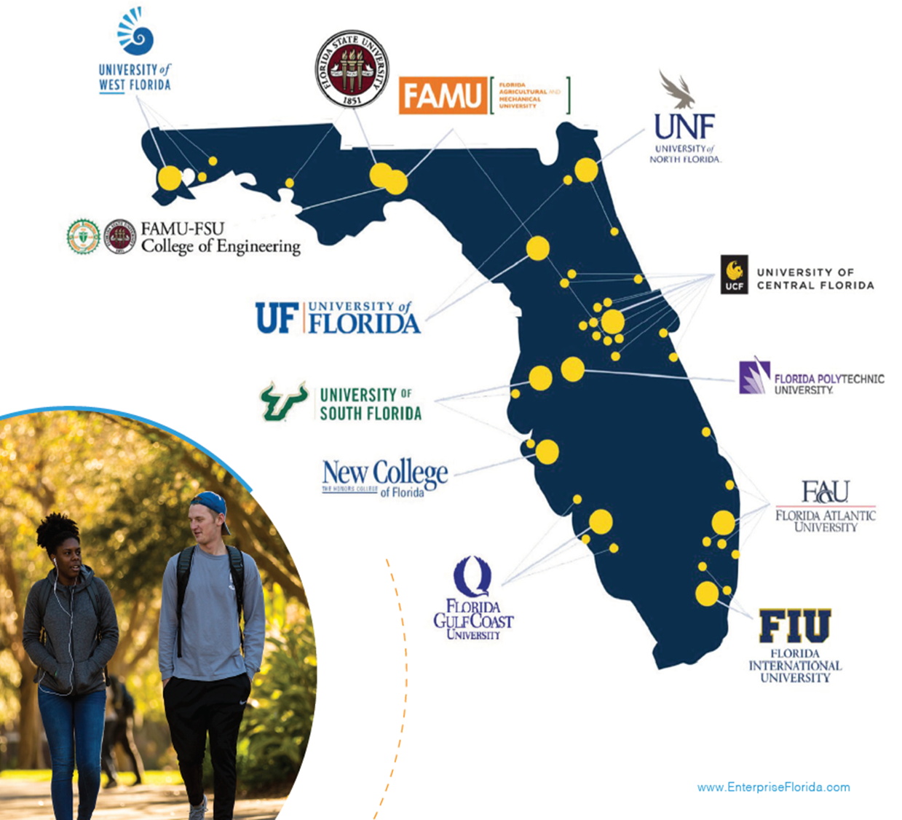
Talent
28 Institutions,
12 Public
72 Campuses
430,000+ Students
97,000+ Degrees Awarded
2nd Lowest Tuition in the Country
Notes:
Source: Interactive data from EFI Website; https://www.enterpriseflorida.com/why-florida/workforce/
2) We invested heavily in making our higher education system affordable and world-class. We also have other preeminent, specialized universities.
NYU vs UF.
Florida’s 10.5 million-strong workforce is highly educated, technically skilled, and culturally and linguistically diverse, renowned for its strong work ethic. Globally prominent academic institutions, modern scientific and technical curricula, businessacademia partnerships, and top-rated customized worker training programs make it easy to find the qualified talent needed by almost any kind of business. Florida’s labor costs are highly competitive, especially compared to other top-tier business locations in the United States and most other advanced economies.
Florida average annual manufacturing wages are 20% lower than those in Texas, and 35% lower than California’s.
2.5 million people in the pipeline.
Not to mention how we benefit from all the talent to our south.
Governor DeSantis has also made it a huge priority to focus on technical education
Tech talent and engineering at a number of bootcamps

Slide 14
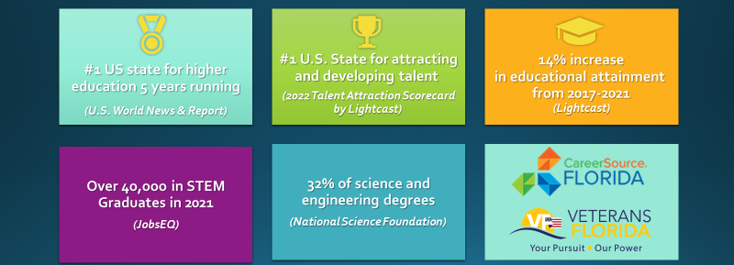
Talent
Notes:
Source: Interactive data from EFI Website; https://www.enterpriseflorida.com/why-florida/workforce/
2) We invested heavily in making our higher education system affordable and world-class. We also have other preeminent, specialized universities.
NYU vs UF.
Florida’s 10.5 million-strong workforce is highly educated, technically skilled, and culturally and linguistically diverse, renowned for its strong work ethic. Globally prominent academic institutions, modern scientific and technical curricula, businessacademia partnerships, and top-rated customized worker training programs make it easy to find the qualified talent needed by almost any kind of business. Florida’s labor costs are highly competitive, especially compared to other top-tier business locations in the United States and most other advanced economies.
Florida average annual manufacturing wages are 20% lower than those in Texas, and 35% lower than California’s.
2.5 million people in the pipeline.
Not to mention how we benefit from all the talent to our south.
Governor DeSantis has also made it a huge priority to focus on technical education
Tech talent and engineering at a number of bootcamps

Slide 15
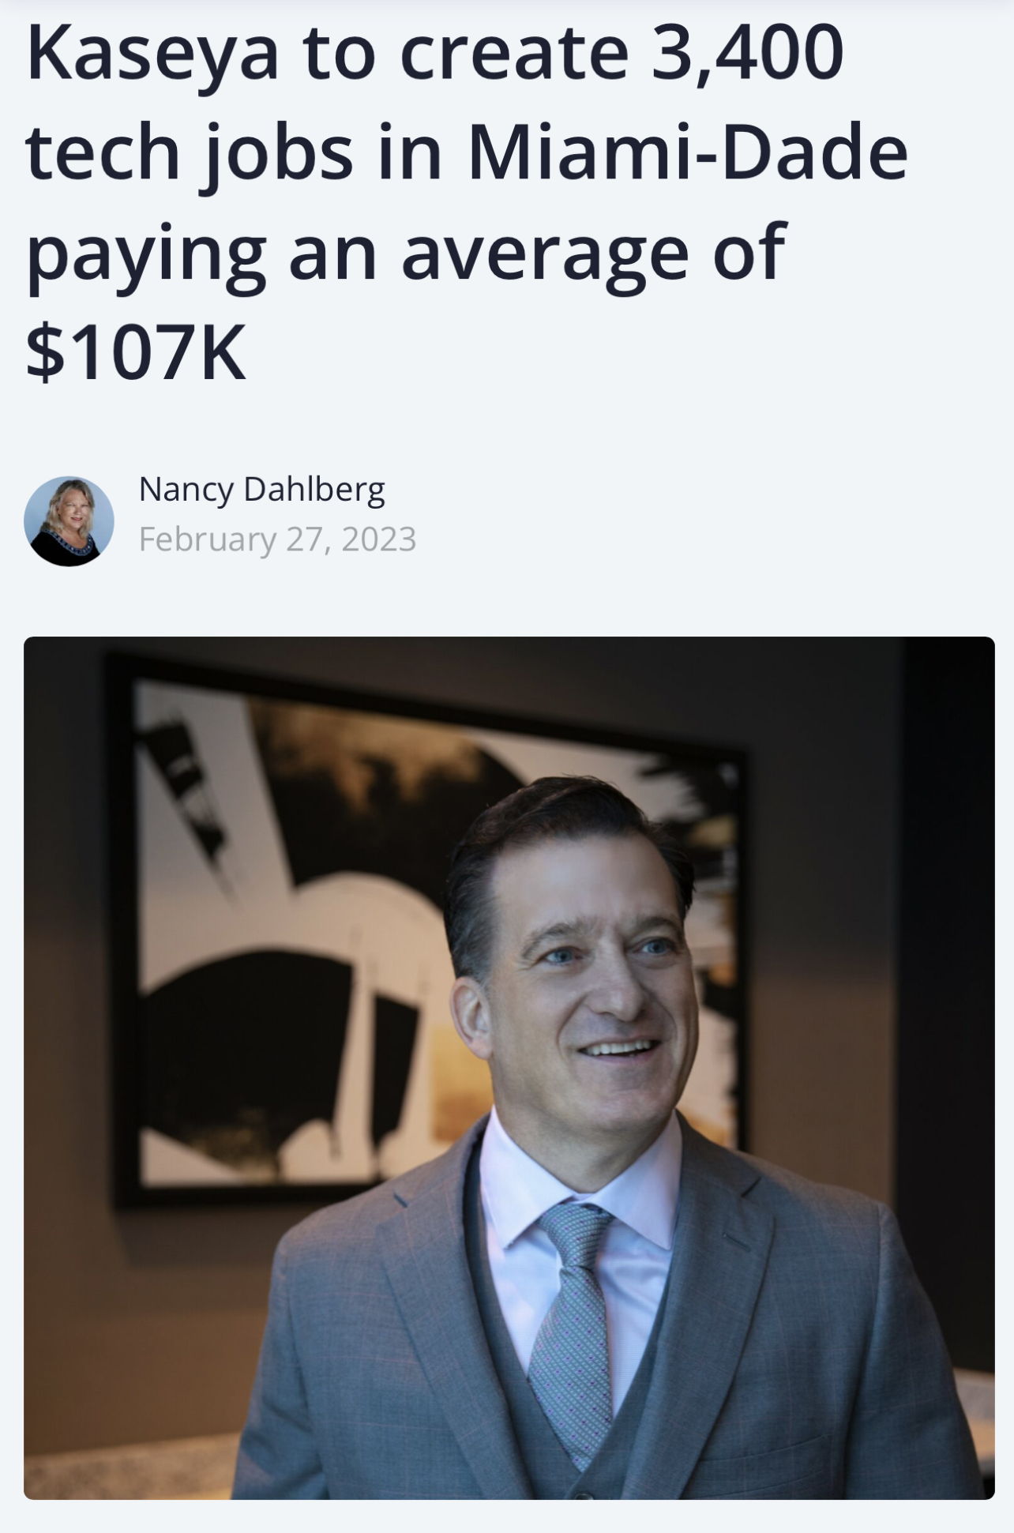
Talent
“The No. 1 reason he cites for being so bullish: the talent.
“If you think about the DNA of Miami, we have a lot of first-generation Americans, a lot of people who fought for the right to be in this country. The work ethic is awesome, the sense of ownership, we have great grit,” said Voccola, a Miami resident who also is an alum of University of Miami. “It’s an awesome labor force.”
He also said the educational systems are focused on preparing students for the real world, not the fabricated world of academia. “It’s very inspiring for us to see that.”
Notes:
Florida’s 10.5 million - strong workforce is highly educated, technically skilled, culturally and linguistically diverse, and renowned for its strong work ethic. Globally prominent academic institutions, modern scientific and technical curricula, business-academia partnerships, and top-rated customized worker training programs make it easy to find the qualified talent needed by almost any kind of business. Florida’s labor costs are highly competitive, especially compared to other top-tier business locations in the United States and most other advanced economies.
2) We invested heavily in making our higher education system affordable and world class. We also have other specialized preeminent universities.
NYU vs UF.
Florida’s 10.5 million-strong workforce is highly educated, technically skilled, and culturally and linguistically diverse, renowned for its strong work ethic. Globally prominent academic institutions, modern scientific and technical curricula, businessacademia partnerships, and top-rated customized worker training programs make it easy to find the qualified talent needed by almost any kind of business. Florida’s labor costs are highly competitive, especially compared to other top-tier business locations in the United States and most other advanced economies.
Florida average annual manufacturing wages are 20% lower than those in Texas, and 35% lower than California’s.
2.5 million people in the pipeline.
Not to mention how we benefit from all the talent to our south.
Governor DeSantis has also made it a huge priority to focus on technical education
Tech talent and engineering at a number of bootcamps

Slide 16
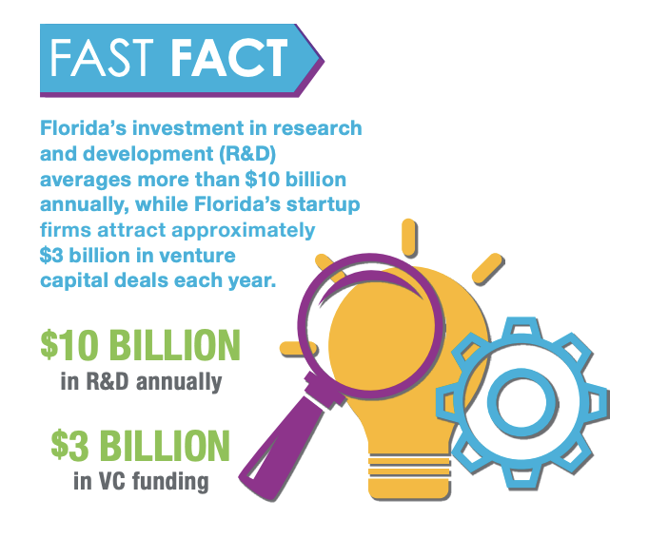
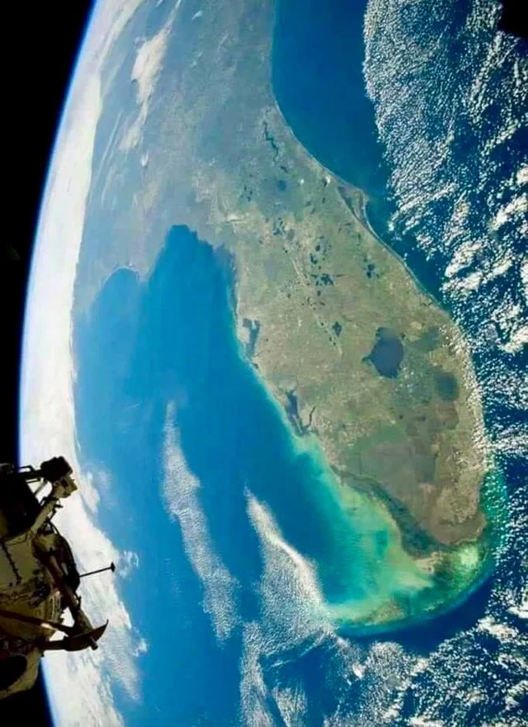
Foundation of Innovation
Notes:
As the home to America’s space program and the birthplace of IBM’s personal computer, Florida has a long history of developing and deploying innovative technologies. Nowadays more than 36,000 high-tech business establishments employ about 600,000 Floridians, generating some $12-13 billion in high-tech exports annually. Florida’s biotech firms are behind some of humanity’s greatest health breakthroughs, while its fintech and cyber security professionals are ensuring the smooth, secure conduct of online business. From marine biology to space exploration, propulsion systems to surgical lasers, Floridians are devising cutting-edge solutions for the next economy.
Florida’s investment in research and development (R&D) averages more than $10 billion annually, while Florida’s startup firms attract approximately $3 billion in venture capital deals each year.
\

Slide 17
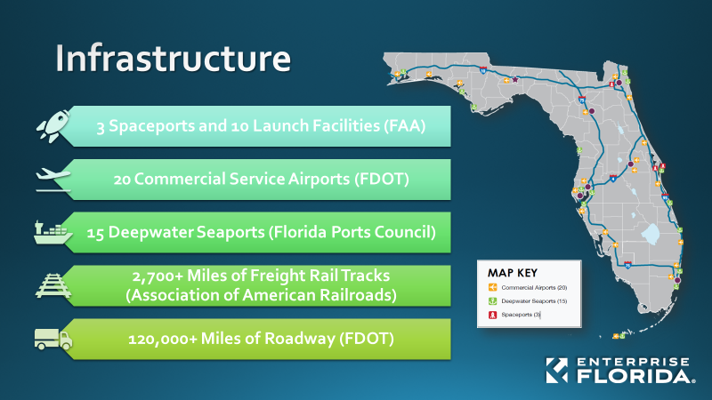
Capacity
Notes:
Florida has made really smart investments in Infrastructure to build capacity.
deeping of the port…
FDOT’s $10B a year work plan… mostly of roads but still
Rail and now with brightline
Airports
Broadband… network accesspoint of America
The Network Access Point in Miami is an example of how Florida connects the world with its innovative data center. This internet exchange point funnels data to South and Central America. As 5G grows and satellites launched from Florida continue to circle Earth, the state is poised to be a leader in the telecommunication sector.
With its state-of-the-art infrastructure, Florida enables the efficient movement of goods, people, and data across the globe. The state’s multimodal transportation system includes 20 commercial airports, 15 deepwater seaports, advanced highway and rail networks, modern fiber-optic telecoms networks, and several major highspeed data transmission hubs. Direct air links enable global passenger and cargo mobility, while numerous shipping routes connect Florida to the world’s leading commercial hubs. Florida is home to one in five U.S. exporters, with the combined annual value of goods and services exports exceeding $100 billion.
\

Slide 18
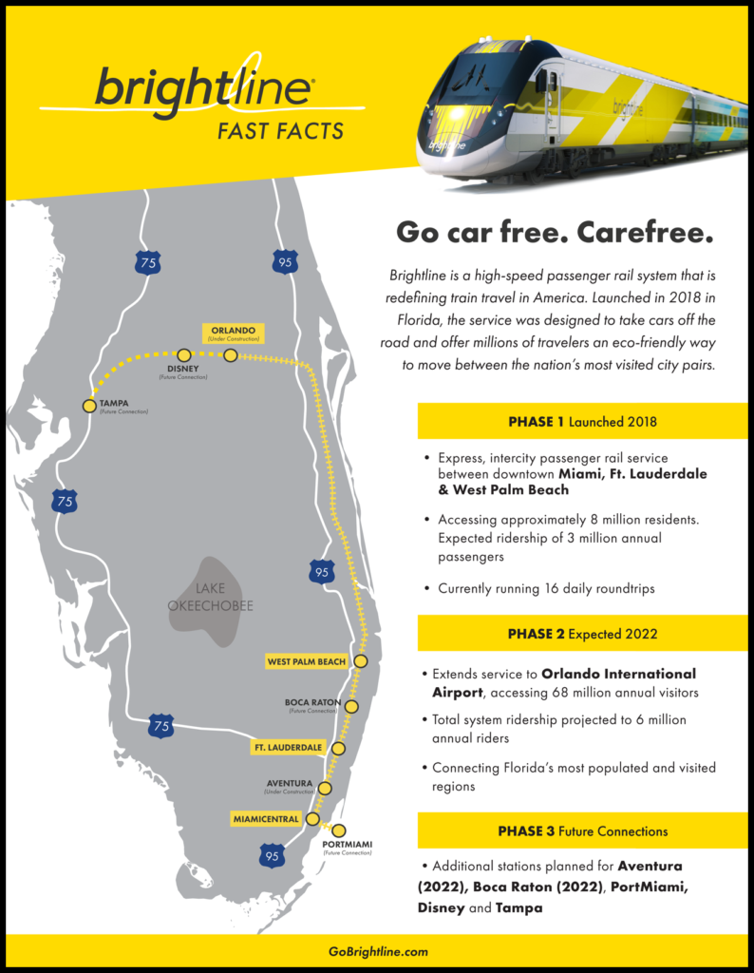
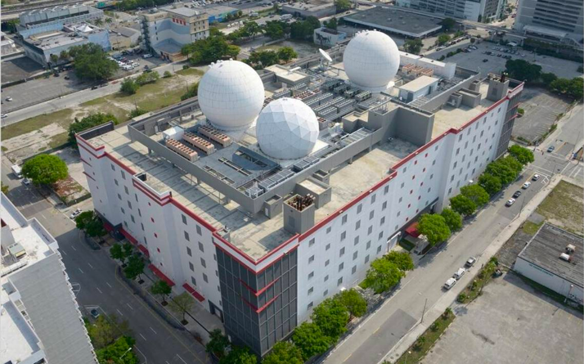
Capacity
Notes:
Florida has made really smart investments in Infrastructure to build capacity.
deeping of the port…
FDOT’s $10B a year work plan… mostly of roads but still
Rail and now with brightline
Airports
Broadband… network accesspoint of America
The Network Access Point in Miami is an example of how Florida connects the world with its innovative data center. This internet exchange point funnels data to South and Central America. As 5G grows and satellites launched from Florida continue to circle Earth, the state is poised to be a leader in the telecommunication sector.
With its state-of-the-art infrastructure, Florida enables the efficient movement of goods, people, and data across the globe. The state’s multimodal transportation system includes 20 commercial airports, 15 deepwater seaports, advanced highway and rail networks, modern fiber-optic telecoms networks, and several major highspeed data transmission hubs. Direct air links enable global passenger and cargo mobility, while numerous shipping routes connect Florida to the world’s leading commercial hubs. Florida is home to one in five U.S. exporters, with the combined annual value of goods and services exports exceeding $100 billion.
\

Slide 19

International Gateway
Notes:
Geography is Destiny!
Florida is host to several thousand affiliates of companies based outside the United States, including hundreds of hemispheric or regional corporate headquarters. Besides corporate HQ’s, many international firms have located other kinds of facilities in Florida, such as manufacturing plants, R&D labs, sales and marketing offices, logistics and distribution operations, and customer service centers, to take advantage of easy access to markets worldwide.
Florida is the Americas’ commercial crossroads. Due to its strategic geographic location, advanced infrastructure, access to finance, and multi-cultural and multi-lingual workforce, Florida serves as the principal gateway to Latin American and Caribbean markets for both U.S. and overseas companies. Florida accounts for about a third of total U.S. trade with Latin America and the Caribbean, and is home to the world’s largest cluster of professional & financial service providers specializing in Latin America.
There are more direct flights from Florida airports to Latin American and Caribbean cities than from the rest of the United States combined. Miami is regularly voted “best Latin American city for business” by CEOs.
As the home to America’s space program and the birthplace of IBM’s personal computer, Florida has a long history of developing and deploying innovative technologies. Nowadays more than 36,000 high-tech business establishments employ about 600,000 Floridians, generating some $12-13 billion in high-tech exports annually. Florida’s biotech firms are behind some of humanity’s greatest health breakthroughs, while its fintech and cyber security professionals are ensuring the smooth, secure conduct of online business. From marine biology to space exploration, propulsion systems to surgical lasers, Floridians are devising cutting-edge solutions for the next economy.
Florida is home to more than 58,000 exporting companies – second only to California. Twenty percent (20%) of the nation’s companies that export are in Florida.
Florida ranks 4th among all U.S. states in high-tech exports – reaching US$13.8 billion in 2021 – and 3rd in the U.S. for the 40.7 thousand direct jobs supported by tech exports in 2018.
One of the most international US states, with global name recognition
A hemispheric hub for business, finance, trade, logistics, travel, and culture
Multicultural & multilingual: 1/5 of Florida’s population (and over half of Miami’s) born outside the United States and speak a foreign language.
One of the highest concentrations of foreign consulates, trade offices, bi-national chambers of commerce, and international banks in the US
Business gateway between Latin America & Caribbean and rest of the world; location for many LatAm regional corporate headquarters, and the US offices of companies based in Latin American countries
Miami regularly voted “best Latin American city for business” by CEOs
As part of the US, Florida enjoys political and economic stability, rules-based legal system, enforceability of contracts, few restrictions on capital flows
Geographic proximity to LatAm, advanced infrastructure, and connectivity
Florida’s diverse, multilingual workforce includes several million native speakers of Spanish, Portuguese, and French – easy to find the right talent
Extensive cultural, linguistic, and family ties to Latin America & Caribbean
Close to 2500 multinational firms, many are regional headquarters for LatAm
The world’s largest cluster of professional & financial service providers specializing in Latin American and Caribbean markets
The largest cluster of international banks in the US outside of New York

Slide 20
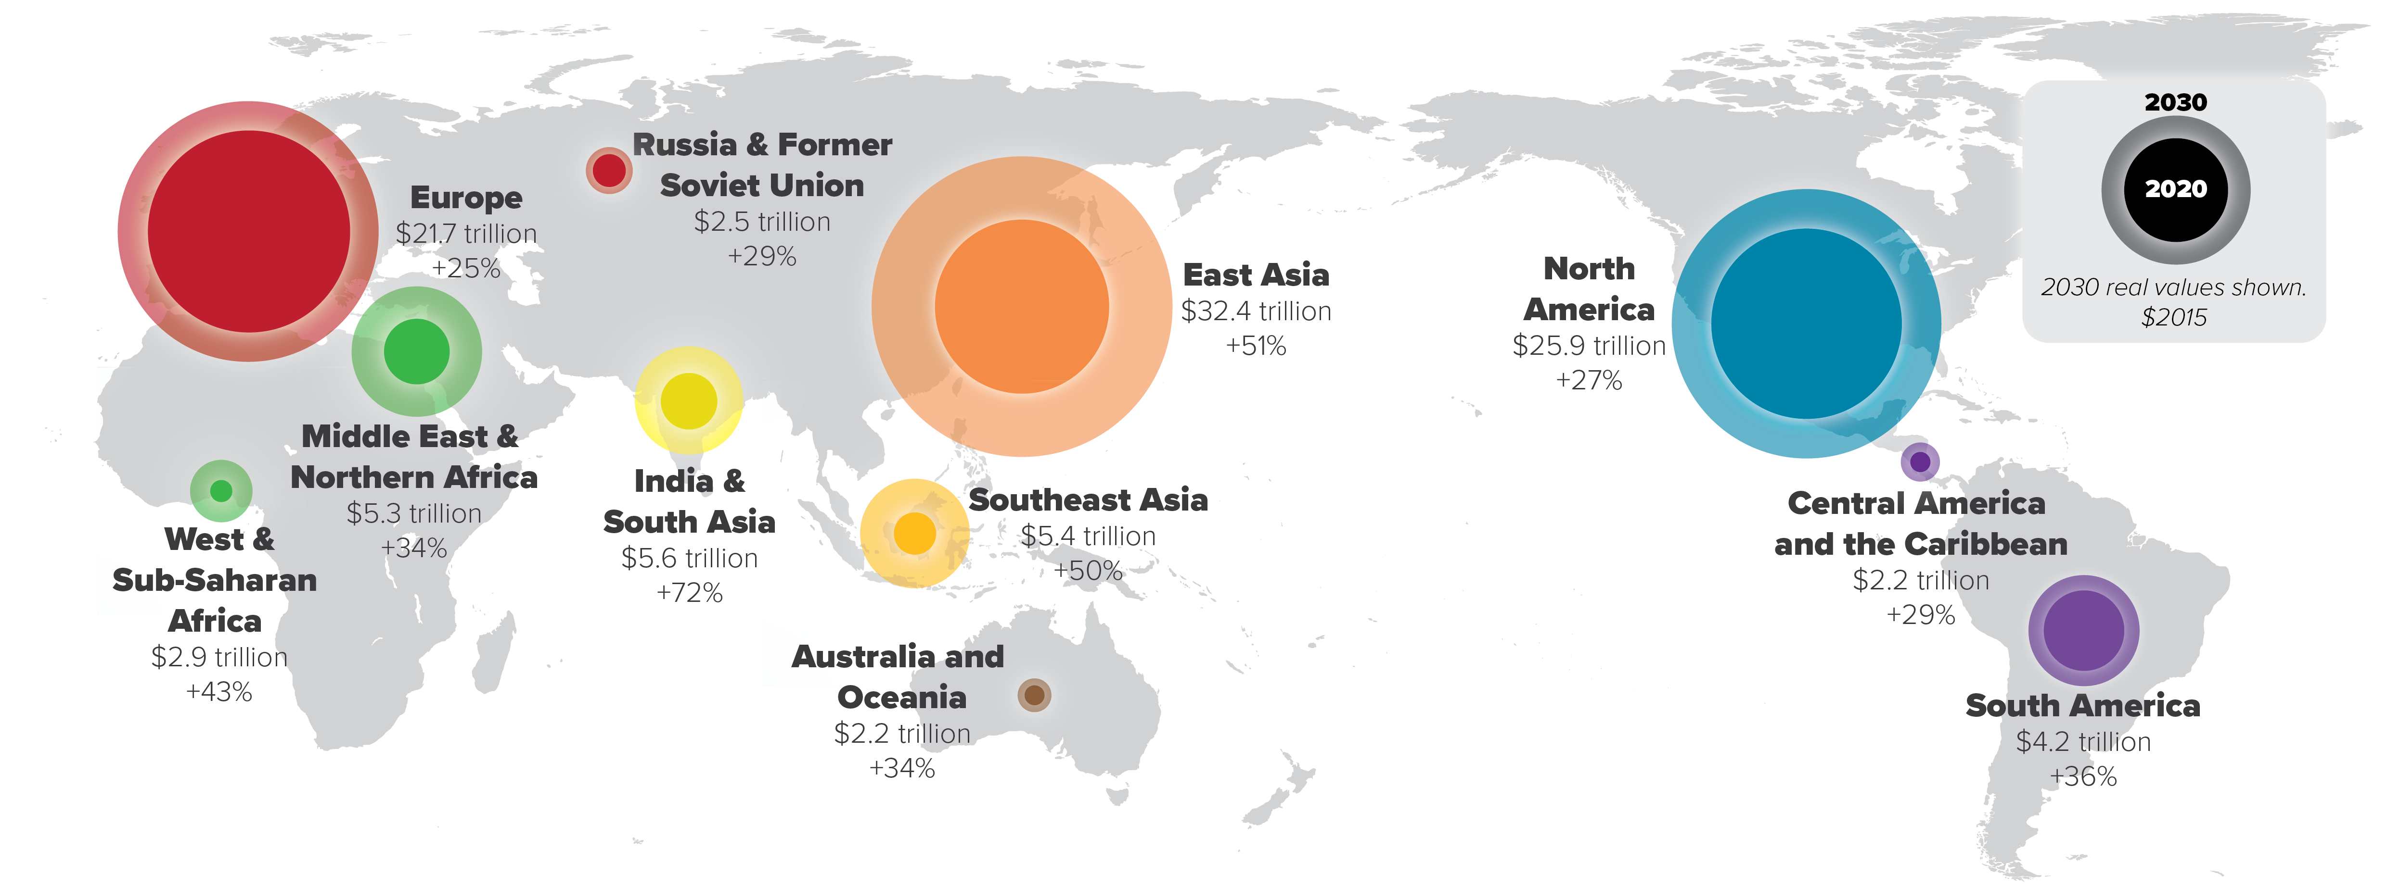
Growing Global Economy
Notes:
75% of the worlds GDP is outside America… 95% of the worlds consumers outside of America… Makes sense to internationalize
Global trade patterns are shifting. China is projected to outpace the United States as the world’s largest economy (as measured by GDP) by 2030. Driven by population growth, emerging markets in South Asia, Southeast Asia, East Asia, and Africa will see above-average GDP growth. Global merchandise trade flows have become more stable since the rapid acceleration of globalized trade in the 1990s and 2000s, while still growing over the past decade.
TL 1.0 and 2.0 focused heavily on the opportunity for more Asian trade through the Panama Canal to Florida. Trade disputes with China, COVID, natural disasters, and war in Europe all have disrupted global supply chains in the past few years. It is possible that we will see a shift back toward regional trade blocs, which would benefit Florida due to its strong position in trade within Latin America and the Caribbean. Continued partnerships with Europe and long-term partnerships with Africa would also benefit Florida.

Slide 21
ATTRACT
GROW
Global Trade Lanes Shifting
HIGHER WAGE
JOB GROWTH AND ECONOMIC RESILIENCY
Continuously evolving
  Expansion of the Panama Canal along with a battery of issues on the US West Coast are contributing to the shift in vessel traffic to the US East and Gulf coasts
    Massive congestion at sea, at the dock, inland
    Labor strikes
      Both dockworker and rail
    Stricter environmental policy
    Bureaucratic regulatory compliance
  Officially 49% - 51% west coast/east coast
    Number will continue to grow
    Makes sense as approximately 80% of the US population lives east of the Texas/Wyoming line
      Southeast stands to benefit the most of any region
        Proximity to Panama Canal
        Business friendly policies
        Room to grow
RETAIN

Slide 22
ATTRACT
GROW
Florida: America’s Commercial Crossroads
HIGHER WAGE
JOB GROWTH AND ECONOMIC RESILIENCY
Florida is positioned to capitalize on this shift from both sea and air
  Already viewed as the Gateway to Latin America
    Strategic geographic location makes it a major gateway for merchandise trade between Latin America, the Caribbean, Europe, and the world
    Advanced infrastructure, access to finance, and multi-cultural and multi-lingual workforce
    Florida accounts for 29% of total U.S. trade with Latin America and the Caribbean
    Pro-business government
    Low tax rates
    Streamlined regulations
    Dynamic growing population 22.5M+, 3rd largest state
    Florida is an economic superstate and the 4th largest economy among U.S. states
RETAIN

Slide 23
ATTRACT
GROW
Nearshoring
HIGHER WAGE
JOB GROWTH AND ECONOMIC RESILIENCY
  Scrutinizing the Americas for the best prospects for nearshoring—considering manufacturing, services, and distance to the continental United States and based on capabilities and performance to date—five countries dominate:
    Mexico, Colombia, Costa Rica, the Dominican Republic, and Panama
      Geography and time zones similar to those of the United States and Canada permit quick and agile collaboration compared with other parts of the world
RETAIN

Slide 24
ATTRACT
GROW
Nearshoring
HIGHER WAGE
JOB GROWTH AND ECONOMIC RESILIENCY
  Another advantage for the Latin American and Caribbean region is the huge and ever-growing talent pool of software product development, systems engineers, and digital technology specialists—all at labor costs far less than in the US and Canada
  Besides the ease of travel due to many airlines having United States hubs serving the region, there is also cultural affinity, made stronger with so many Spanish-speaking US citizens, both Hispanic and non-Hispanic
RETAIN

Slide 25
ATTRACT
GROW
Nearshoring Correlation
HIGHER WAGE
JOB GROWTH AND ECONOMIC RESILIENCY
  Florida’s largest export markets are Colombia, Panama, Brazil, the Dominican Republic, and Mexico.
  Today’s best prospects for nearshoring are Mexico, Colombia, Costa Rica, the Dominican Republic, and Panama
  In this ever-changing environment we could not be positioned better and stand ready to serve you
RETAIN

Slide 26

Florida: Gateway to SPACE!

Slide 27

ATTRACT
GROW
Space Economy
HIGHER WAGE
JOB GROWTH AND ECONOMIC RESILIENCY
  Over 90 countries now operate in space
    Of those, eight (U.S., China, Russia, European Space Agency, India, Iran, Israel, Japan) launch consistently and can obtain orbital access
    Florida is the launch capital of the world
      2022: 57 mission launches took place in Florida
        87 total in the U.S.
      2023: ~90 launches projected launches from Florida
RETAIN

Slide 28

ATTRACT
GROW
Space Economy
HIGHER WAGE
JOB GROWTH AND ECONOMIC RESILIENCY
  Space Florida has had a $5.9 billion economic impact on Florida since 2007
    Projected $1.1 billion economic impact annually
    Part of that $5.9 billion impact includes:
      $2.8 billion in GDP throughout Florida
      $1.7 billion in household income
      $548 million in federal, state, and local fiscal revenues
  Space Florida is responsible for nearly 20% of the aerospace workforce in the state.
RETAIN

Slide 29
ATTRACT
GROW
Space Economy
HIGHER WAGE
JOB GROWTH AND ECONOMIC RESILIENCY
  Space Foundation's Space Economy Report valued the global space economy at $469 billion in 2021
    9% increase from 2020
  Space industry should reach $1 trillion in annual revenue by 2040, with launch costs dropping 95%
  Commercial space sector saw 6.4% revenue growth since 2020
  Space Report notes that government space budgets worldwide reached $107.3B in 2021
    Increase of 19% over 2020
RETAIN

Slide 30
Direct Flight to Florida: Making the Case for MIA
Florida has the 3rd largest U.S. population and nearly one-third of Florida residents live in MIA’s service area

Slide 31
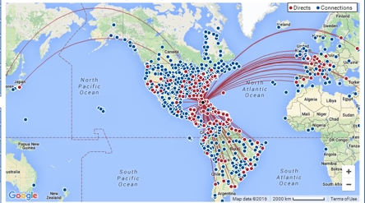
Direct Flight to Florida: Making the Case for MIA
In 2021, Miami became the highest-ranking U.S. gateway for international passengers and freight
MIA has regained its air service levels, routes and seat capacity lost during COVID faster than any other US gateway

Slide 32
Direct Flight to Florida: Making the Case for MIA
In 2019, Tokyo was Miami’s 2nd largest Asian market, after Manila which is too distant for a nonstop flight
JAL serves 11 U.S. points from the Tokyo Airports, notably absent
is service to the presently leading international U.S gateway,
Miami

Slide 33
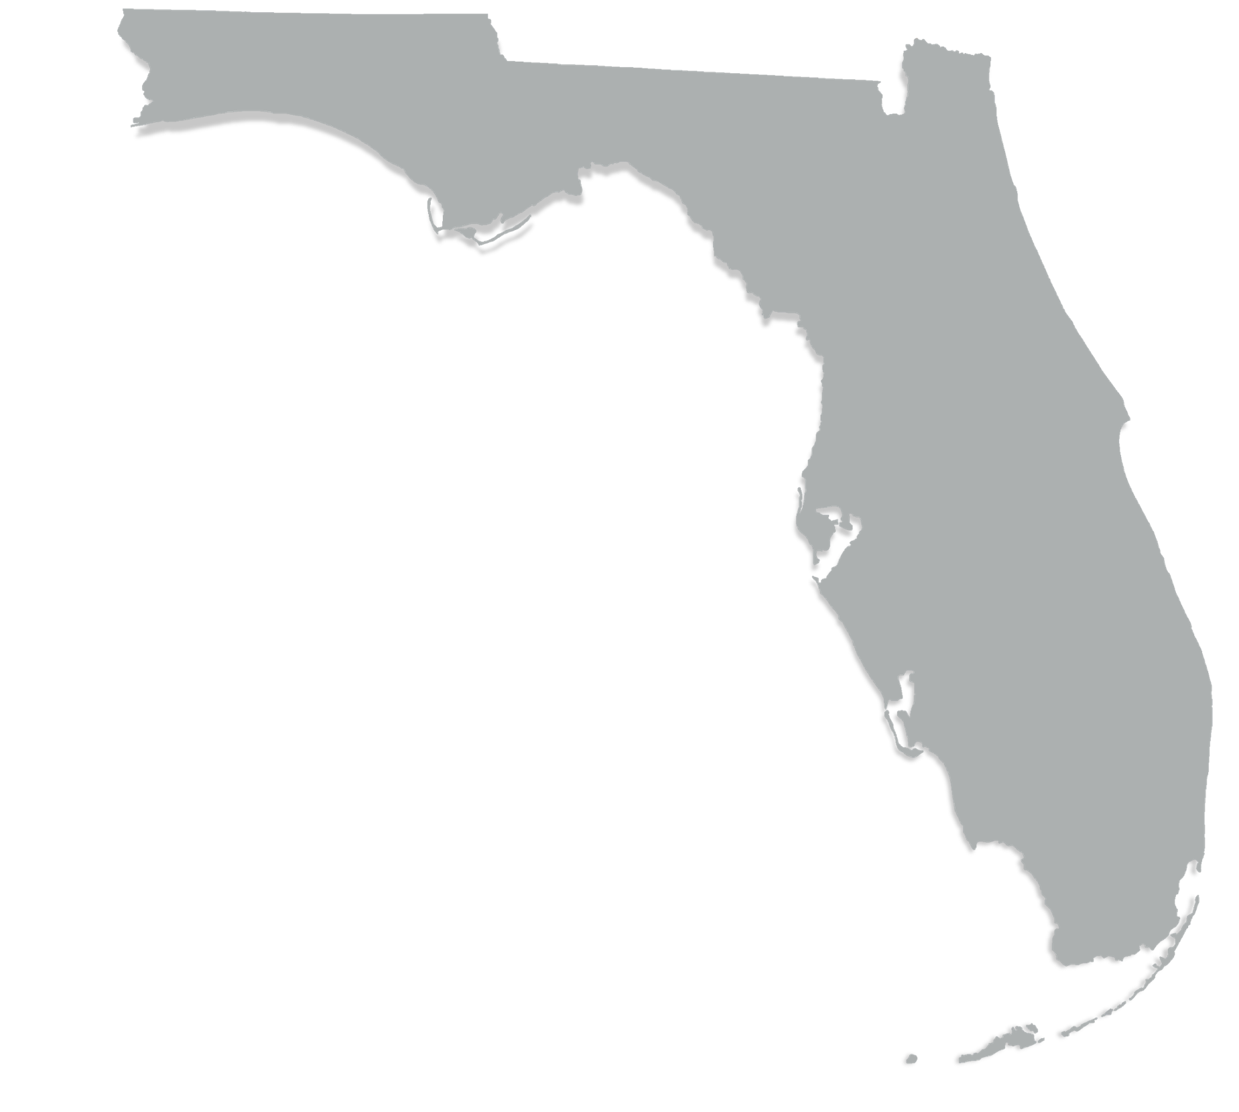


Direct Flight to Florida: Making the Case for MCO
According to 2019 U.S. Census estimates, Asians represented 5.7% of Orange County’s population, almost double that of Florida’s 3%
A non-stop from Orlando to Tokyo would provide a one-stop connection to the rest of the Asia Pacific region to other important markets for MCO such as Manila, Beijing, Shanghai, Ho Chi Minh City and Seoul
Orlando is home to the largest Japanese company in Florida, Mitsubishi Hitachi Power Systems, as well as Mitsukoshi, and over 80 other Japanese companies have a presence in the Central Florida region
Florida companies like Universal Studios can benefit with easier transit to their Japan and Asia pacific properties

Slide 34
Direct Flight to Florida: Making the Case for MCO
Asia to Orlando MCO passenger traffic has increased 13.4% since YE 2/2017 from 442,656 passengers to 502,074 in YE 2/2020
MCO is the largest U.S. market without nonstop service to Asia YE 2/2020 when compared with MIA, PHX, PHL, RDU
MCO Asia traffic is 45.8% larger than MIA
  502,074 MCO Asia passengers vs 344,324 for MIA YE 2/2020
MCO is the largest U.S. market without nonstop service to Japan and 328.5% larger than MIA-Japan- YE 2/2020
  167,541 MCO vs 39,097 for MIA
MCO is the largest U.S. market without nonstop service to Tokyo Narita and 236.3% larger than MIA-Tokyo Narita- YE 2/2020
  85,466 MCO vs 25,414 for MIA

Slide 35
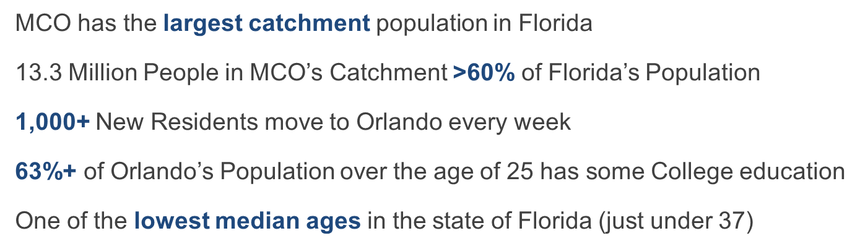
Direct Flight to Florida: Making the Case for MCO

Slide 36
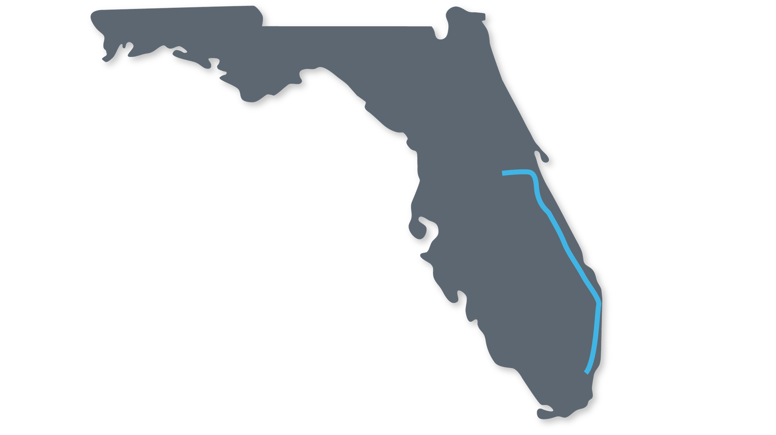



Direct Flight to Florida: Making the Case for MCO
  Only U.S. Inter-city rail service from an airport
  Will operate from MCO to city centers in
  West Palm Beach, Ft. Lauderdale, and Miami
  Estimated start date: Summer 2023
MCO
2 HRS
PBI
30 MIN
FLL
MIA
30 MIN

Slide 37
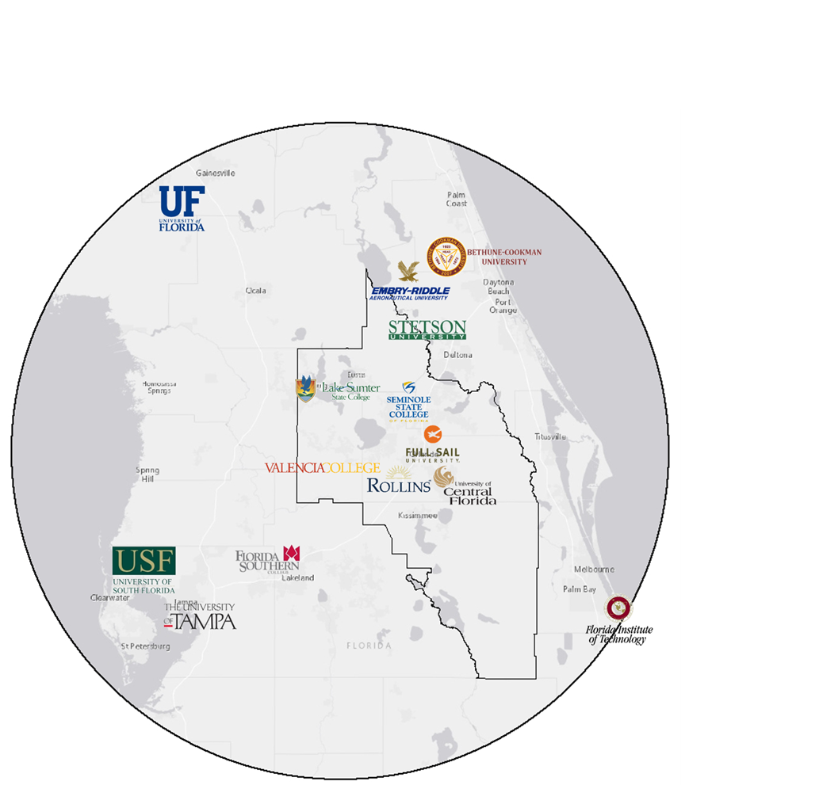
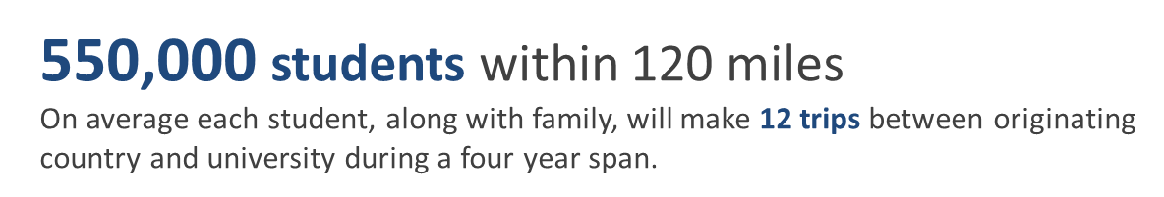
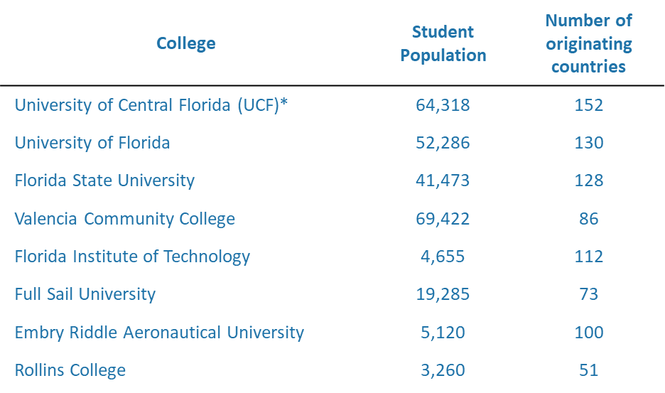
Direct Flight to Florida: Making the Case for MCO

Slide 38
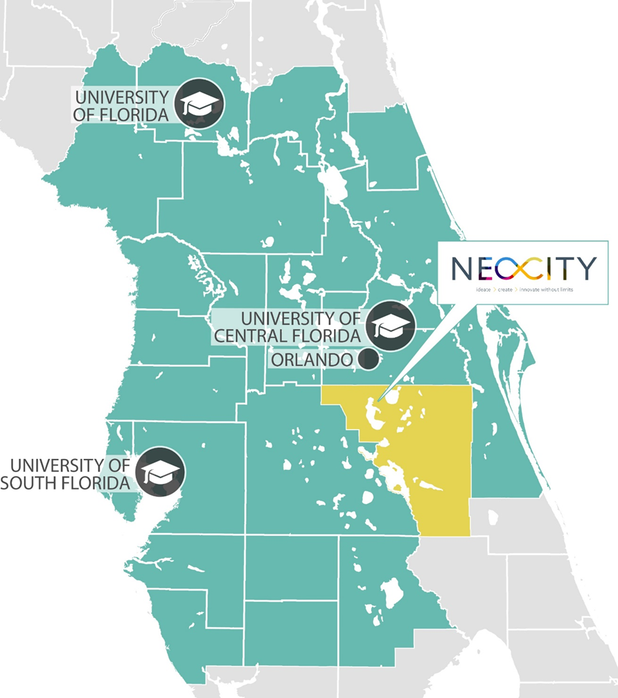
Direct Flight to Florida: Making the Case for MCO
NeoCity is a 500-acre technology district in Osceola County, Florida, inspired by an ethos of collaboration and designed to transform the way we ideate, create, and innovate.
Burgeoning concepts will gestate into mature technologies here, from smart sensors and photonics to software applications and process improvements in science and engineering.

Slide 39

Thank you!
@FollowMeToFL

Slide 40
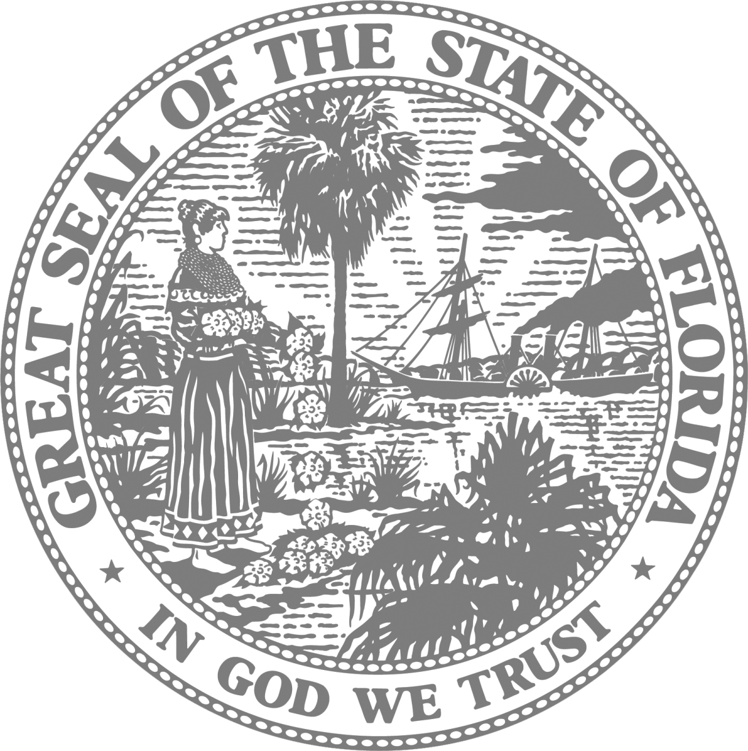
Enterprise Florida Offices
Contact Information
Orlando
800 North Magnolia Avenue, Suite 1100 Orlando, Florida 32803
Tallahassee
101 North Monroe Street, Suite 1000 Tallahassee, Florida 32301
Miami
(International Trade & Development)
201 Alhambra Circle, Suite 610 Coral Gables, Florida 33134
EnterpriseFlorida.com
linkedin.com/in/lauradibella
ldibella@enterpriseflorida.com

